Slide 1
Setting the Stage
Shakespeare’s Julius Caesar

Slide 2
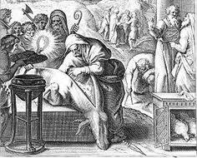
Superstitions
Emperors as Gods/ control the populace
Politics of “signs” and “omens”
Animals as deceased ancestors
Animals as sacrifice
Haruspex– soothsayers specialized in the reading of entrails
Chickens to predict military outcomes
Bad omens: owls, solar eclipses, lightning, dreams

Slide 3
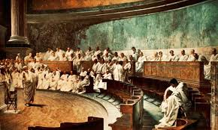
Rule by the Rich
The Forum= stage; politicians=actors; citizens=audience
Roman Republic established in 509 BC
Republic– a state in which the power is vested in the citizens, who are entitled to vote; they elect representatives who govern on behalf of the citizens
  Two types: representative democracy and direct democracy
Only the rich were allowed to run for/hold public office
  When in Rome…
  “For the people, by the people”

Slide 4
Political structure of Roman Republic
Consuls (2)
patricians (aristocracy)
Senate (300)
patricians
Assembly
plebians (adult male citizens)

Slide 5
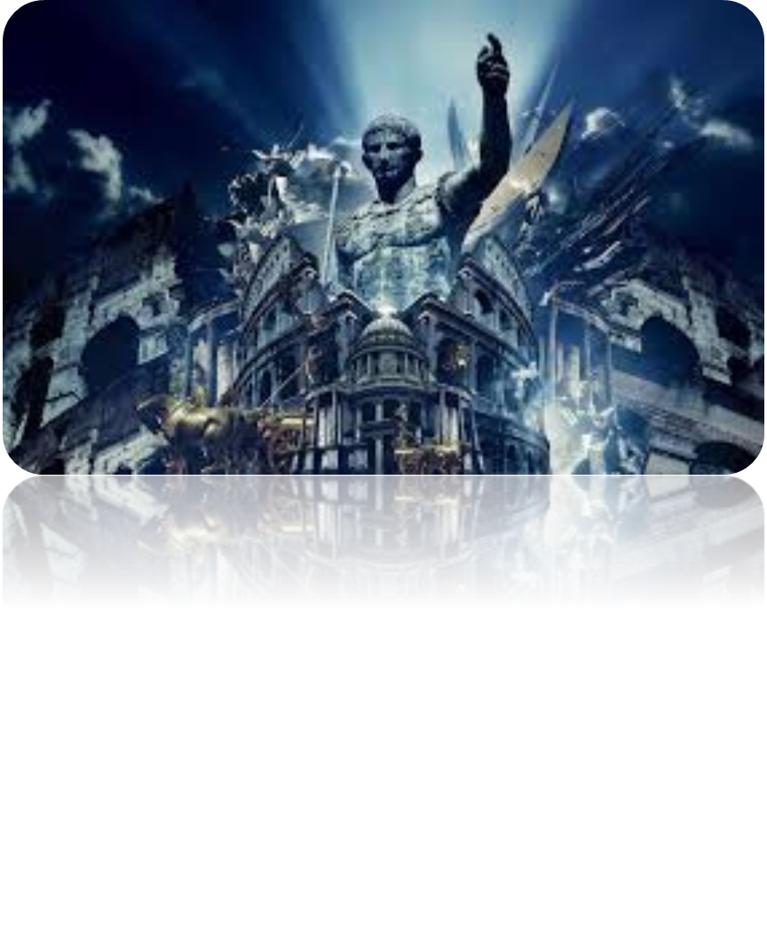
Life of Caesar
Julius Caesar (c. July 12 or 13, 100 BC to March 15, 44 BC) was a politically adept and popular leader of the Roman Republic
  While Julius Caesar hailed from Roman aristocrats, his family was far from rich. When Caesar was 16, his father, Gaius Caesar, died.
By age 31, Caesar had fought in several wars and become involved in Roman politics. After several alliances, he became dictator of the Roman Empire.
  The strategic political alliance among Julius Caesar, Crassus and Pompey came to be known as the First Triumvirate.

Slide 6
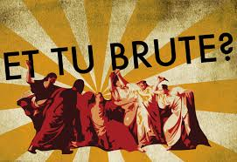
Julius Caesar was assassinated by political rivals, led by Cassius Longinus and Marcus Brutus, on the Ides of March (the 15th), 44 BC.
  Although he would serve just a year's term before his assassination, Caesar’s rule proved instrumental in reforming Rome for his countrymen.
  Caesar's great-grandnephew Gaius Octavian assembles an army to fight back the military troops defending Cassius and Brutus.
  His victory over Caesar's assassins allowed Octavian, who assumed the name Augustus, to take power in 27 BC and become the first Roman emperor.
  With Caesar’s death came the end of the Roman Republic

Slide 7
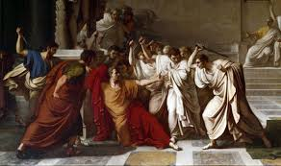
Aristotle’s Tragedy
Tragedy is mean to arouse both pity and fear in the audience so that we may be purged, or cleansed, or these emotions
catharsis= emotional purging; a sense of exhilaration or calm after experiencing a great tragedy
A tragedy’s central character is neither completely good nor completely bad
Tragic hero= character who suffers a downfall or reversal of fortune as a result of their own errors or flaws
Tragic flaw= fundamental character weakness such as pride, ambition, jealousy, etc; the tragic hero will come to realize their flaws prior to end of play

