Slide 1
The Great Gatsby by F. Scott Fitzgerald
Historical background, author information, themes, and motifs to look for
"I look out at it and I think it is the most beautiful history in the world. . . . It is the history of all aspiration not just the American dream but the human dream and…that too is a place in the line of the pioneers.“
- The Notebooks of F. Scott Fitzgerald, ed. Matthew J. Bruccoli

Slide 2
The 1920s – The Jazz Age
Fitzgerald himself coined the term
Reaction to the death/destruction/loss of innocence from WWI (post-war prosperity)
During this time, there was a mass migration from rural areas to cities where “parties were bigger, the pace was faster, the buildings were higher, the morals looser” (Fitzgerald)
Some called it the first truly modern decade
Louis Armstrong and Duke Ellington were popular musicians of the day
Dances like the Charleston, the Shimmy, and the Toddle were popular (http://www.youtube.com/watch?v=yNAOHtmy4j0)

Slide 3
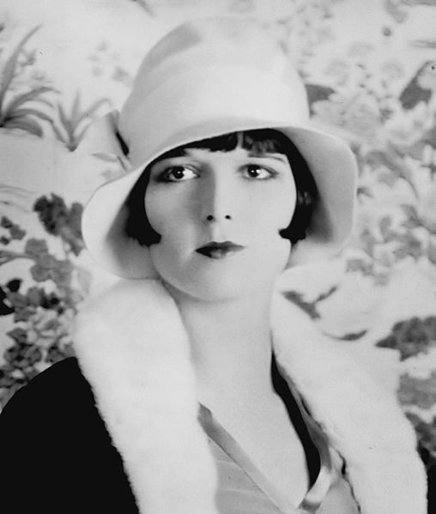
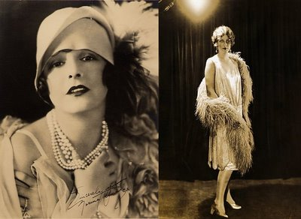
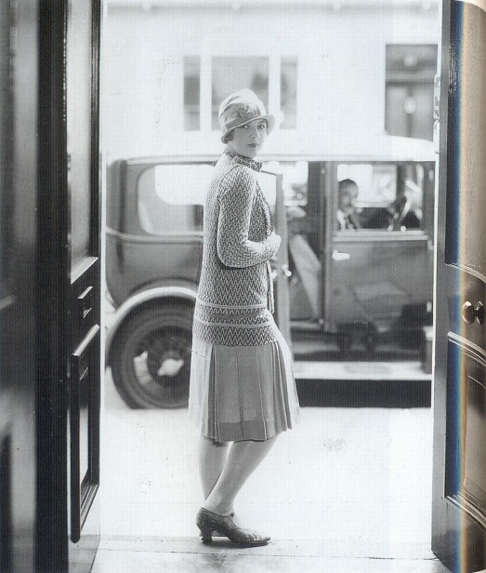
Women’s fashion of the 1920s

Slide 4
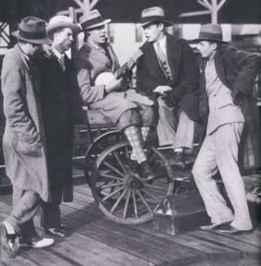
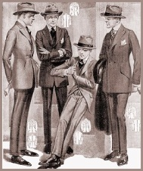
Men’s fashion of the 1920s

Slide 5
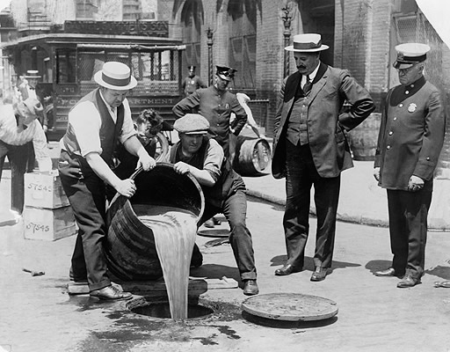
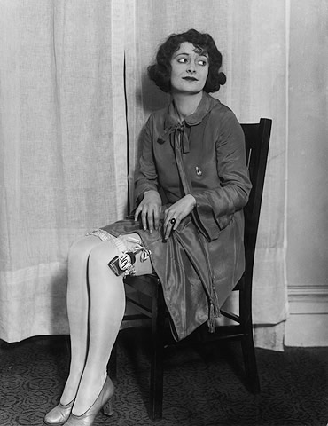
Prohibition
1920-1933 – sale of alcohol was prohibited in the United States; mandated by Constitutional amendment
Meant to improve lives of Americans (faith-driven initiative)
Instead, liquor consumption grew exponentially
Created criminals (lots of $$ to be made) – Gatsby?
Speakeasies were the places to consume liquor (bars)

Slide 6
F. Scott Fitzgerald
Born September 24, 1896
Died December 21, 1940
Only son of an “aristocratic
father” and “energetic mother” –
named after Francis Scott Key, a relative of his father’s
Went to private schools and attended college at Princeton
Leading figure in a dramatic society, The Triangle Club
Neglected his studies – flunked out and joined the army

Slide 7
F. Scott Fitzgerald
Met his wife, Zelda, while
stationed in Alabama
She refused to marry him due
to his lack of success
1920 - published his first novel
This Side of Paradise – it made him famous!
Zelda agreed to marry him
Called the “prince and princess” of the generation
The couple had a daughter, Scotty, in 1921

Slide 8
F. Scott Fitzgerald
The family moved to
the French Riviera
Wrote Gatsby there
Part of a group of ex-pats that included Ernest Hemmingway
In 1930, Zelda had the first of several mental breakdowns
Sent to sanitarium in Switzerland; she spent the rest of her life in both inpatient and outpatient care
The couple returned to America for good in 1931

Slide 9
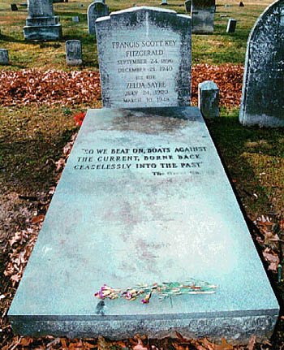
F. Scott Fitzgerald
Although Fitzgerald
was a famous author, the
couple spent the money much faster
than he earned it.
1935-37 is known as the “crack up” in Fitzgerald life
Decent into alcoholism
In debt
Unable to be a present father for Scotty (sent to boarding schools)
Fitzgerald went to Hollywood in 1937 to try his luck at screenwriting
He won a substantial contract with MGM, but still wasn’t financially viable due to his debt
Met and fell in love with Sheilah Graham
Fitzgerald died of a heart attack in Graham’s apartment in 1940
Zelda died in a fire in 1948

Slide 10
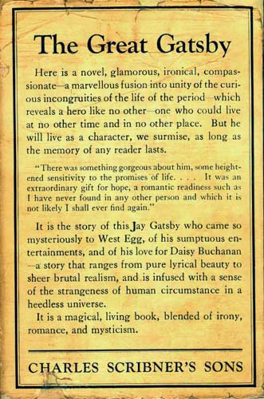
Famous Works
Novels
Magazines, Newspaper Short Stories
This Side of Paradise (1920)
The Beautiful and the Damned (1922)
The Great Gatsby (1925)
Tender is the Night (1934)
The Last Tycoon (unfinished)
Featured in Esquire, The Saturday Evening Post
All the Sad Young Men (best collection of short stories)

Slide 11
The Great Gatsby (1925)
Characters
Nick Carraway – narrator; cousin to Daisy
Jay Gatsby – mysterious central figure; in love with Daisy; lives in West Egg (new money)
Tom & Daisy Buchanan – Tom is an ivy-league, retired polo champion; Daisy is a Southern debutante; live in East Egg (old money)
Jordan Baker – Daisy’s best friend; based off Edith Cummings, 1923 women’s golf champion
George & Myrtle Wilson – Tom’s mistress and her mechanic husband; live in the “valley of ashes”– land between East Egg and NYC
Meyer Wolfshiem – “business associate” of Gatsby; based on Arnold Rothstein, a real-life gangster

Slide 12
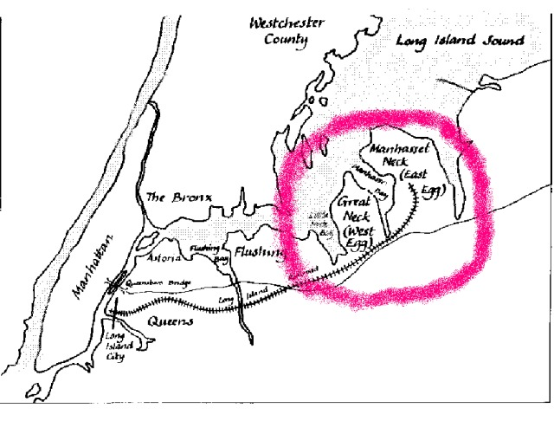
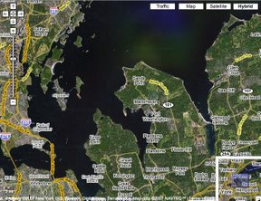
The Great Gatsby (1925)
Setting
The East and West Eggs – fictionalized peninsulas on Long Island Sound (Hamptons)
East Egg – representative of “old money”; Tom and Daisy live here
West Egg – the newly rich live here – not quite accepted into the folds of the old moneyed; Gatsby’s mansion is here

Slide 13
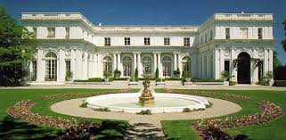
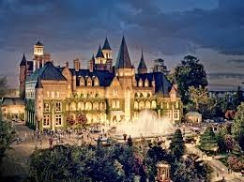
The Great Gatsby (1925)
Setting
Gatsby’s mansion: set on 40 acres; colossal, flashy, garish; setting for weekly parties
Symbolic of Gatsby’s success and the “American Dream”
Also symbolic of the hollowness of money, success
Serves as Gatsby’s lure for Daisy

Slide 14
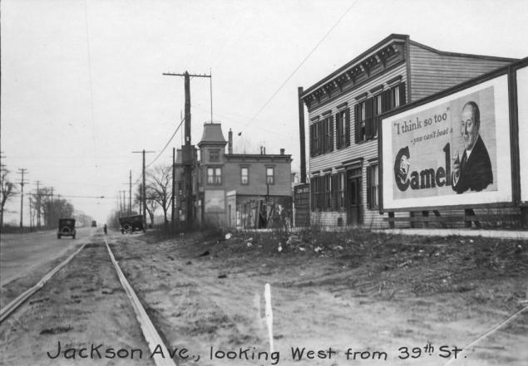
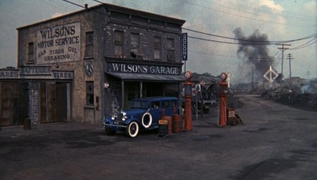
The Great Gatsby (1925)
Setting
Valley of Ashes - where George and Myrtle live
Considered to be Flushing, in Queens, NYC
Dead, gray, powdery
People passed through the area in cars and on trains on their way to and from Manhattan

Slide 15
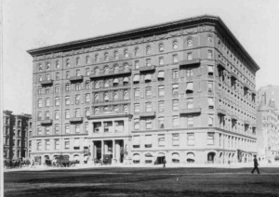
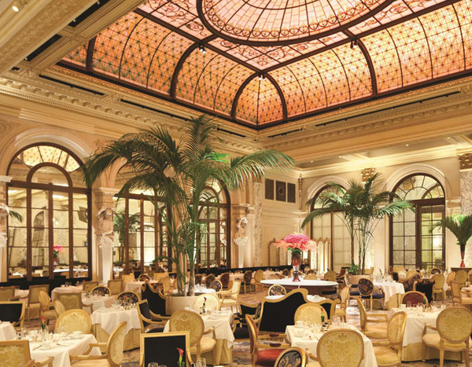
The Great Gatsby (1925)
Setting
New York City and Plaza Hotel – symbolizes excess of the times
Where much of the irresponsibility (adultery) and excess (drunkenness) of the novel take place

Slide 16
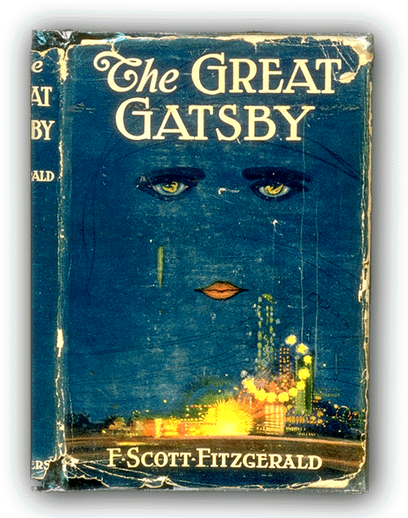
The Great Gatsby (1925)
Motifs
Money
Hypocrisy
Friendship
Carelessness
Dishonesty
The American Dream
Cars/Driving
Ashes/Dust
Time/Clocks
Colors: green, white, yellow, silver, gold

Slide 17
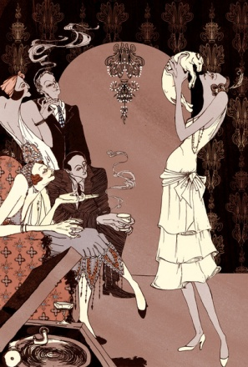
The Great Gatsby (1925)
Symbols
The green light at the end of Buchanan’s dock
Gatsby’s library/books
Dr. T.J. Eckleburg’s eyes on the billboard
Owl Eyes
Valley of Ashes
East Egg/West Egg

Slide 18
SOURCES
http://www.pbs.org/kenburns/prohibition/about/
http://www.swisseduc.ch/english/readinglist/fitzgerald_fscott/geo.html
http://www.pbs.org/wgbh/amex/monkeytrial/peopleevents/e_jazzage.html
http://reading.cornell.edu/reading_project_06/gatsby/great_gatsby_resources.htm
http://www.biography.com/people/f-scott-fitzgerald-9296261
http://image1.findagrave.com/photos250/photos/2009/345/344_126064520224.jpg
http://i.telegraph.co.uk/multimedia/archive/01813/FScott_1813988b.jpg
http://www.brunswick.k12.me.us/hdwyer/the-great-gatsby-study-guide/
http://s3.amazonaws.com/cmi-niche/gallery_photos/36676/images/slideshow_feature_Palm-Court----Credit-The-Plaza.jpg?1348853726
http://3.bp.blogspot.com/-uq_qjeAiprA/UMYtlVxtBwI/AAAAAAAAA2w/-bwxOSQ1yiw/s1600/4.jpg
http://thegreatgatsbysandm.blogspot.com/2011/05/valley-of-ashes.html

