Slide 1
Intro to Homer’s
The Illiad and The Odyssey

Slide 2
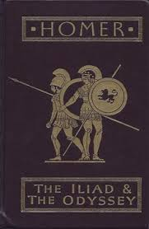
Who was Homer?
Homer= hostage
Greek poet
Blind?
rhapsode
800 BCE
The Iliad and the Odyssey– the “Bibles” of Greek Civilization

Slide 3
Greek/Trojan values
Arete
Warrior’s possessions/ spoils of war
Pantheon of Gods and Goddesses= ACTIVE
RESPECT for the dead

Slide 4
Conventions
Invocation
In media res
Flashbacks
Epic similes (Homeric)
Metrical structure (dactylic hexameter)
Stock epithets

Slide 5
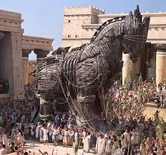
The Iliad
10 years
Greeks/ Trojans
Aphrodite/Athena/Hera-- Helen of Troy
Agamemnon/ Priam
Patrocles
Achilles vs Hektor
Odysseus and the Trojan Horse
Paris

Slide 7
The Odyssey

Slide 8
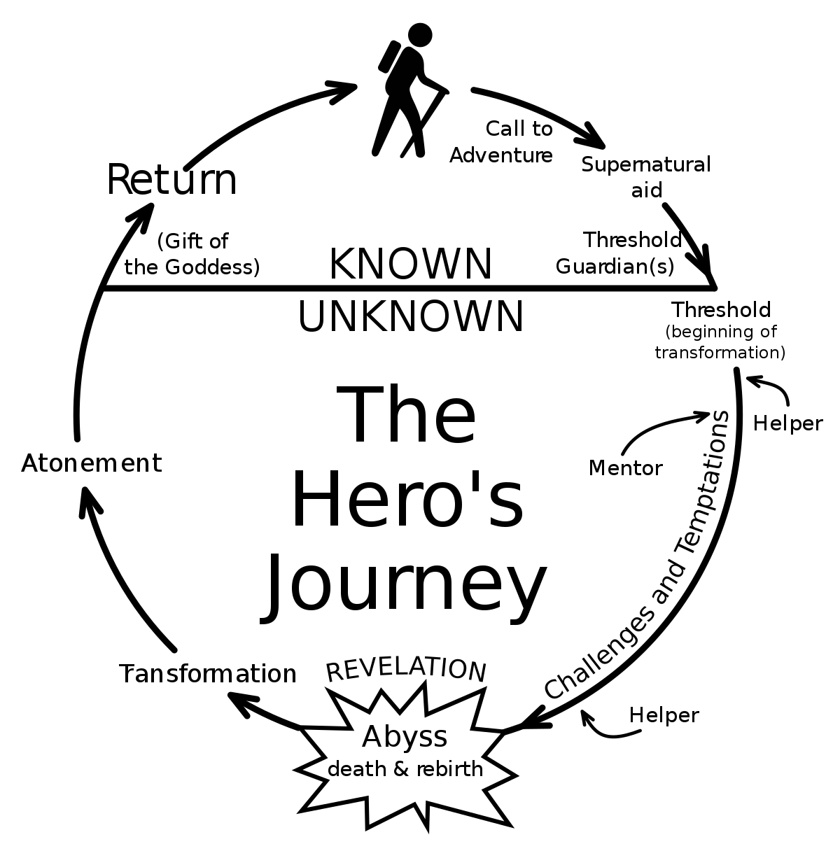
The Odyssey
Odysseus, King of Ithaca
Return from Trojan War
Cunning; skills with a bow and arrow
10 years
Cyclops, sirens, cannibals, hydra, enchantresses

